Slide 1
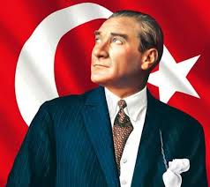
Atatürk
Who was the “father of the turks”
Acar Tuna Yılmaz BBAHL

Slide 2
Selanik
Selanik was the door to the Europe for Ottoman empire. İt was at the Europe, this cause the new ideas that have born in Europe was taking place here. This place had railways and harbours which carried İdeas and newspapers…

Slide 3
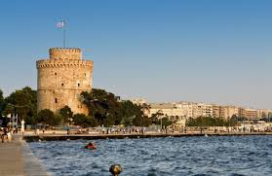
Two pictures from Selanik’s White Tower.

Slide 4
Selanik had different cultures with Greeks, Turks, Jews, Bulgars. So Mustafa Kemal learnt this cultures and people From childhood. İn this part of Ottoman Empire, people were intelligent and There were an area for every idea. This Freedom of expression provided Mustafa Kemal to develop his self-confidence.

Slide 5
Education Life
Atatürk was a clever student and good Charactered person. He went to military’s Shools, which was giving the best Education at that time. He was one of the Best students in his schools.

Slide 6
Mustafa Kemal is posing with his friends in school years.He is posing with His fez, which he don’t like ( Later he changed with modern hat by “Hat Law”.) and his moustache is trendy for that time among men in Turkey.

Slide 7
In the middle school, his teacher gave Him the name “Kemal” which means
Fullness, perfection, maturity in Turkish Due to his behaviours.

Slide 8
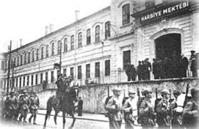
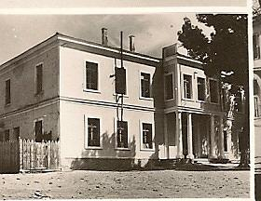
You can see two of schools that he went.

Slide 9
In high school and university, he learnt New languages like French. French was The way to connect with outher world.He Read the books from French Revolution’s Intellectuals. These kinds of books made Him believe and think about human Rights, democracy and independence.

Slide 11
His early service for military
He serviced as a attache in Sofia/Bulgaria.
Here, he affected by art and modern
Events. He went to theatres and proms.
İn proms he meet with politicians and
Other important people. He experienced
Diplomacy here. Also, to him a new country
For the Turks, should care more about art.

Slide 12
Wars after wars…
He always believed peace. To him war Could only be in a situation that you Should protect your motherland, so a war Without this purpose was a murder.
He was a clever man who saw the price And prize of the war…

Slide 14
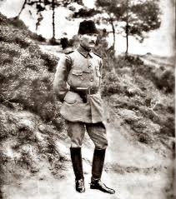
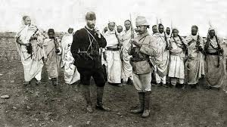
Mustafa Kemal played a huge role in wars that he attended.

Slide 15
“…In 1914, World War I started. Atatürk
Wanted to fight actively. Finally, he went Tekirdağ by order of his superiors. Then, he
Went to Gelibolu (Çanakkale) to join fifth army. Atatürk and his men was assigned to
Support the army. Their duty area was at the back of the war area. Mustafa Kemal
Atatürk knew the area, so, he guessed that English, French and Anzac armies would
Land Seddülbahir and Arıburnu. He went to Arıburnu without any order of his
Superiors and he repulsed the enemy army. This military success was unbelievable
And he got a lot of reputation. Maybe it was the reason that so many people gathered
Around Atatürk and they fought against Greek, English, French, Italian, Armenian
Armies in Turkish Independence War. He was promoted to colonel. After that, enemy
Armies attacked Çanakkale shores many times but every time Mustafa Kemal Atatürk
Repulsed them and defended Gelibolu against them. After his successes, people
Started to call him “Anafartalar Kahramanı”, it means “Hero of Anafartalar”.
Anafartalar is a part of Gelibolu. This success provided October Revolution. If we lost
Çanakkale, it means we lost İstanbul. Because there was no obstacle (line of
Defense) between Çanakkale and İstanbul…”

Slide 16
Turkish War of İndependence
Mustafa Kemal saw the bad situation of Motherland. The monarchy was totally Unactive to invaders. They weren’t doing Anything so Mustafa Kemal and patriots Decided to go to Ankara. Ankara was in The middle of Turkey and it wasn’t Invaded. They chose here to act and fight With invaders. For this and to control the Region they opened a council.

Slide 17
“ when you think Turks were destroyed, one morning they will unite again and
Fight back…”
Greek general ( later president) İoannis Metaxas

Slide 18
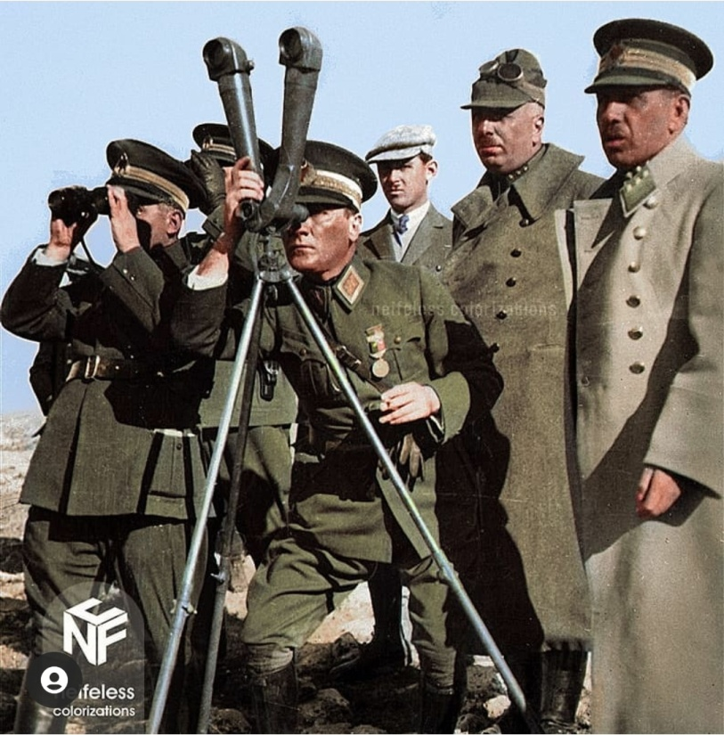
Victory!..
Turks won the war. Now Turkish people’s Leader was “Atatürk”.

Slide 19
With Lausanne Treaty Turkey’s borders accepted. Dark red area shows
The borders that planned by invaders and other area shows the borders
That drew in treaty.

Slide 20
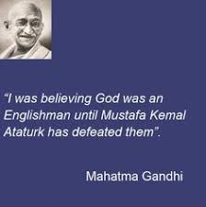
İndependence
Turkey’s indepndence, make colonized Countries couraged. Like İndia which Was at the control of British, tried to gain Independence. Gandhi has a saying,

Slide 21
Republic and Ideas
After independence, the veteran council Of Turkey was in a situation that should Choose the regime of a new country. After tough discussions, republic has Chosen with the support of Mustafa Kemal.

Slide 22
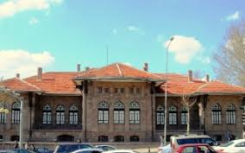

Slide 23
Republic was the dream of Mustafa Kemal.
In his education life, he always dreamed
Democracy for Turkey. He could be the
New king but he didn’t. İt was his amazing
Character…
After declaration of republic, people chose
Mustafa Kemal for presidency.

Slide 24
After republic a new challenge for Turks
Began. Modernisation…
With the Atatürk (which means “father of
The Turks, he got this surname with the
“Law of Surnames”) Turkey was looking
To Future…

Slide 26
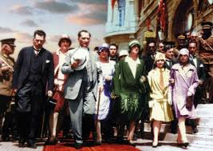
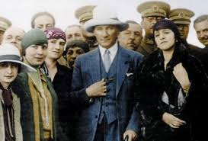
Turkey developed very fast that nobody
Can’t even imagine. First laws prepared
Under the name “Anayasa”. Clothing
Changed, democracy get stronger with
Laws like “Modern Law” which equalized
Women and men in social life in 1926. And
Then women also gained voting right for
Every election in 1934. This cause Turkey
İs one of the countries that gave women
The right of voting in early time when we
Compare with other countries.

Slide 27
“Human kind is made up of two sexes, Women and men. Is it possible that a mass Is improved by the improvement of only One part and the other part is ignored? Is It possible that if half of a mass is tied to Earth with chains and the other half can Soar into skies?”
Mustafa Kemal ATATÜRK

Slide 28
Rise…
At these times Turkey was shining. Relationships with other countries were Really good. When Turkey was Developing quickly it didn’t forget Science and education.

Slide 29
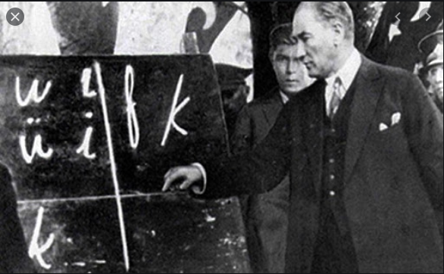
Ataturk ‘s Turkey was giving everybody a chance to learn.
Reading-writing schools established in many cities in Turkey for
The elderly people. Atatürk sent many Turkish students to study
Abroad. He established many institutions such as the Turkish
Historical Society and the Turkish Language Association. He himself
translated many terms in Mathematics and Geometry into Turkish.
He attached great importance to Turkish and wanted the Turkish
equivalent of all words to be used instead of foreign origin.
Atatürk gave importance to teachers. He
Said to them, The next generation is your
Work. Atatürk often visited the readings
And chatted with the teacher and the
Students. I often talked to teachers about
Education and gave importance to their
Opinions.

Slide 30
Other Developments in Education
-Union of Education
With this law which made in 3 March 1924, all foundations of education
Combined and controlled by National Education Ministry. High schools,
Primary schools and universities opened instead of different kinds of
Schools.
-A New Alphabet
In 1 November 1928 Ataturk made “Change of Alphabet”. Latin
Alphabet’s letters started to use in Turkish Language instead of Arabic
Letters.

Slide 31
Once Einstein wrote a letter to Atatürk to make his good scientist friends
Sent there.(İt was because of the Nazi regime in Germany)

Slide 32
A lot of factories opened, İnfastructure
Built, world was watching a true
Success story…
“Every factory is a castle…”
M. Kemal Atatürk

Slide 33
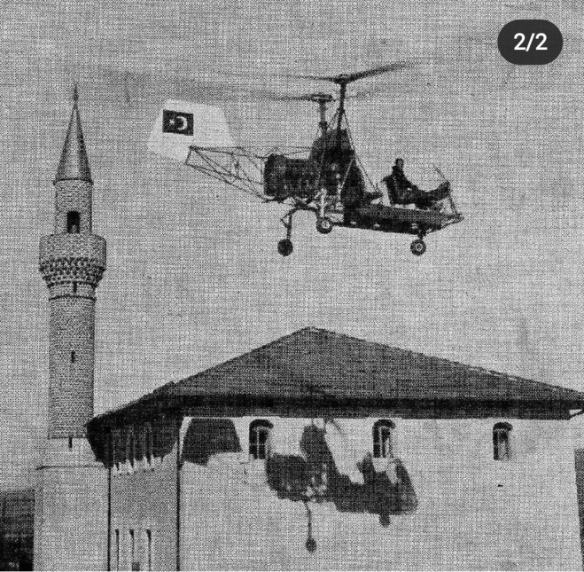
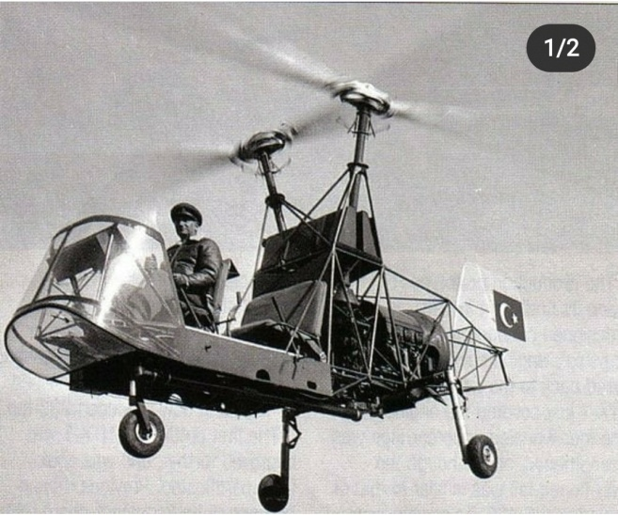
Just two examples for you. Bozkurt train
And Kaman helicopter. They both
Producted in first part of 20th century.

Slide 34
A Turkish magazin wrote in French after republic, to introduce new Turkey

Slide 35
Atatürk always cared about art also in Turkey, he supported art with every Possible thing…

Slide 37
Atatürk was highly interested in music. He both like Turkish folk music and Western music. He and other Turks Organized proms and operas. Also it is Good to know,Atatürk was dancing very Well. He was dancing zeybek( a Turkish Folk dance) very well so people called Him “Sarı Zeybek” which means blond Person who dances zeybek. Also he knew Waltz very well too.

Slide 38
A picture that shows Atatürk with zeybeks. Zeybeks are the People who lives in Aegean part of Turkey. They defended there
While Atatürk and council were trying to build an army. The Dance of zeybek is actually belong this people.

Slide 39
“Ataturk is a modern and courageous leader who has not weakened his mind with archaic beliefs. For him, we can easily say that Ataturk, is the most potent statesman of Europe today, is undoubtedly the bravest and most original statesman of our time.” Herbert Sideabotham / Writer (England)
“Mustafa Kemal is the heart of the new Turkey. He created a fresh, strong nation from an old, torn society, and proved himself to everyone with his unique personality, and convinced everyone with his energy.” Ma Shao- Cheng / Writer (China)
“His work with intelligent and peaceful methods will mark traces in the history of mankind.” – Albert Lebrun / President of France

Slide 40
Love of nature
Atatürk was respectful to every living Thing. After independence war he found Ankara very arid so he began to form a Place for the nature and the people both. He began to do these in a bad area, Almost like a desert. But at the end he Showed his nation that even there is a Piece of badland you can turn it a Miracle.

Slide 41
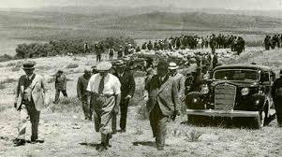
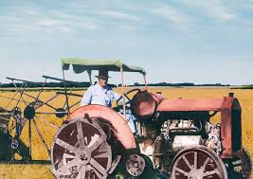
In the beginning of farm…

Slide 42
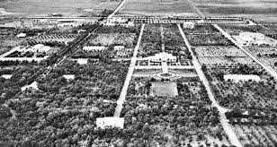
At the end there was a green place for both people and animals…

Slide 43
Legacy
Atatürk loved children.For him children
Were tomorrow’s people who should
Develop Turkey. In Turkey we count
Atatürk as our father. We are proud to
Have a legacy from Atatürk and we
Are the ones who will make Atatürk’s
Dream come true!..

Slide 45
Long live republic!

Slide 46
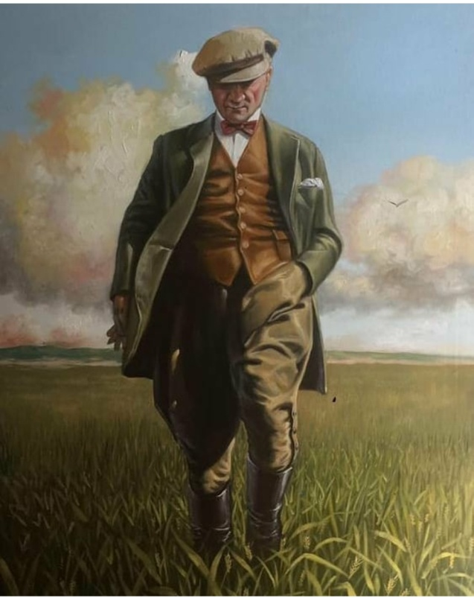
Ne mutlu Türk’ üm diyene!
M. Kemal Atatürk

Slide 47
Thank you for joining us in this presantation.
Innovation Without Boundaries
BURAK BORA ANATOLIAN HİGH SCHOOL

Slide 48
Contributed by…
Teacher administrator: Suzan Pıçakçı
Edited by : Acar T. Yılmaz
Producers: Bengisu Sarı, Nilay Subaşı, Efe Süzen,
Yasemin Fidancı, Hakan Mutlu, Acar T. Yılmaz,
Berat Arda Aydın, Tuna Bircan, Güçlü Kutlu,
Hazal Yavru, Ayşe Rana Taştan, Zeynep Duman,
Eren Şahin Özcan, Roja Bitim
IWB - Innovation Without Boundaries

