Slide 1
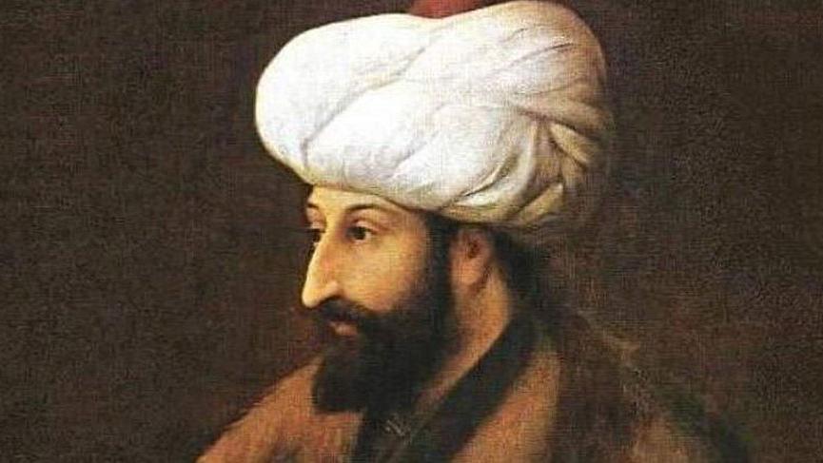
Fatih sultan mehmet
Burak Bora Anatolian Highschool

Slide 2
Who is Fatih Sultan Mehmet?
- Fatih Sultan Mehmet , as known as Mehmet the Conqueror , was born in 30 March 1432 in Edirne.
- He is the 7th Sultan of the Ottoman Empire.
- He is the son of Murad II and father of Bayezid II.
- He managed the empire in his childhood for a short time because of his father's resignation. He defeated the crusade led by John Hunyadi after the Hungarian incursions into his country broke the conditions of the truce Peace of Szeged.

Slide 3
- Then his father died and Mehmed II ascended the throne again in 1451. He strengthened the Ottoman navy and made preparations to attack Constantinople. At the age of 21, he conquered Constantinople (modern-day Istanbul) and brought an end to the Byzantine Empire.
- Mehmet started a new expedition towards Anatolia in 1481. But he fell ill at the beginning of the road and died on May 3 , 1481 at the age of 49. People think he died because of Gout. But some rumors say he died by poisoning.

Slide 4
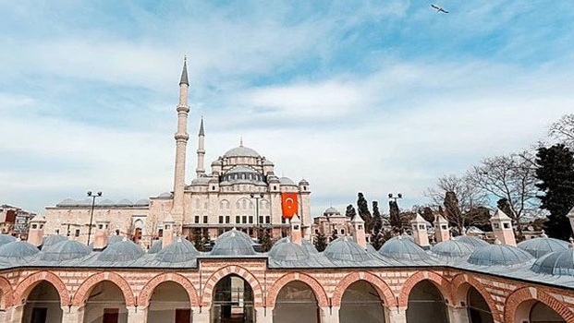
His education :
Fatih Sultan Mehmet received a high degree of religion and science education since childhood. In fact, He had the necessary military knowledge and skills. He knew more than one language . For example; Arabic and Persian. He had big library and many kinds of book. Also , Fatih Sultan Mehmet interested in firearms and he made the drawings of the first air cannon in history. He was someone who gave importance to education. Fatih Sultan Mehmet founded Shan-ı Seman where is one of the oldest known university in Ottoman Empire history.

Slide 5
THE
CONQUEST
OF
CONSTANTINOPLE

Slide 6
Preparation :
Constantinople, as it was then known, was capital of the Byzantine Empire. It was surrounded by many Muslim states.
In a prophecy about its conquest by a Muslim king, Prophet Muhammad had said: “Istanbul will surely be conquered; what a good commander is the conqueror, what a good soldier is the conqueror.”
Sultan Mehmet II, also known as Mehmet the Conqueror, led an army and conquered Istanbul in 1453.
Mehmet II gave orders to prepare for a siege of Edirne, a northwestern province of present-day Turkey which shares a land border with Greece.

Slide 7
In 1452, Zaganos Pasha, a formidable Ottoman commander, fortified the Anatolian Fortress and finished building the Rumanian Fortress, boyh overlooking the Bosphorus Strait. The idea was to block military assistance to the Byzantine Empire in Istanbul through the Black Sea.
Urban, a Hungarian cannon caster, prepared cannonballs that would be fired from the Rumelian Fortress.
The cannonballs submerged the ship of a trespasser, Venetian Antonio Rizzo in the Bosphorus.
This success made it crucial to build larger cannonballs to demolish the walls of Istanbul. So, cannonballs weighing 600 kg (1,322.77 pounds) with a diameter of 62.6 cm (2.03 feet) were casted in Edirne.
After the cannonballs were brought to Istanbul and the Rumelian Army arrived, Mehmet II demanded that Byzantine Emperor Constantine XI should leave the city and declared war.

Slide 8
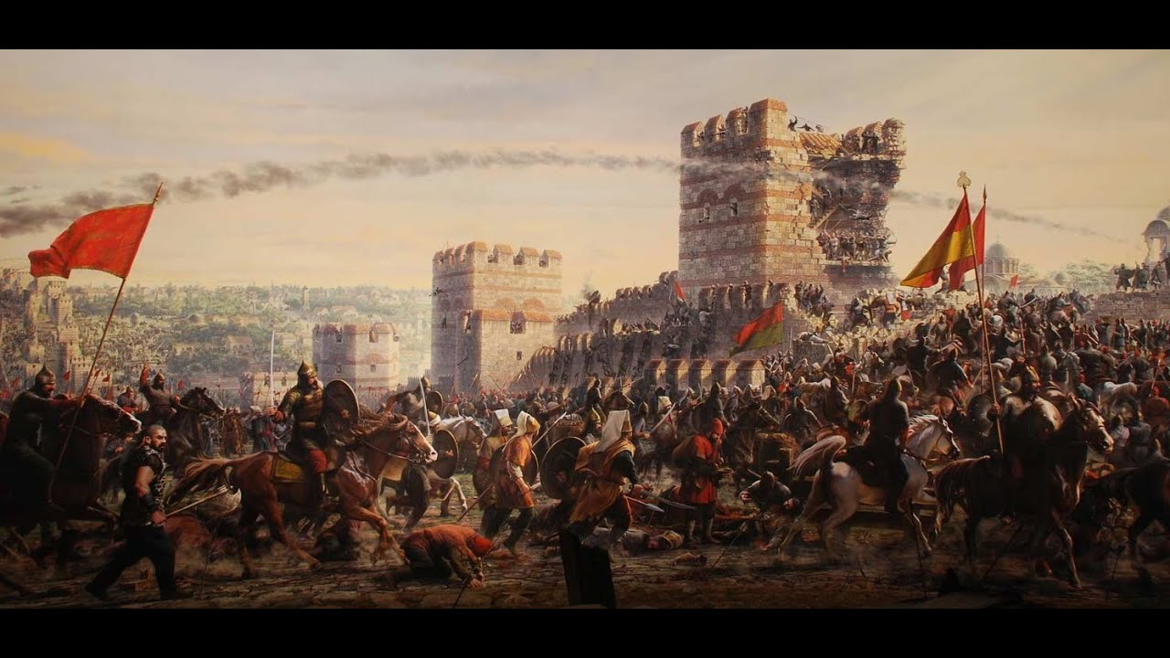
First attack :
The first attack was carried out on April 18, 1453, but it failed causing losses to the Ottoman army.
Moreover, defenders of the city received military assistance from three Genoese and one Byzantine ship, which broke the Ottoman blockade in the Bosphorus on April 20.
Aksemseddin, his teacher, a famous scientist and wise man of the era who supported the Sultan in those difficult days, wrote a letter to the Sultan saying the siege must go on. This is the only document of the incident which has been preserved to this day.

Slide 9
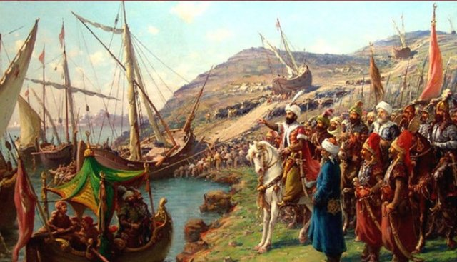
Moving ships on ground
A second plan was put in place. Some (around 60) ships were moved toward the Golden Horn on a road through a small cove with the help of men and oxens.
The ships reached the Golden Horn on April 22 shocking the Byzantine army which was hopeful of assistance from Genoese ships.
Six days later, Venetian Admiral Giocomo Coco failed to destroy Ottoman ships and was buried in the Golden Horn waters with his ship.
On May 6, the Ottoman army shifted its focus on the city walls between Topkapi and Edirnekapi, which had been weakened due to cannonballs.

Slide 10
Rumors cause despair
Meanwhile, the Hungarian ambassador came to the Ottoman army and threatened that a Crusader army would set sail if the siege was not called off. Byzantinian men also sneaked into the Ottoman army spreading rumors that help was coming for the enemy from the Balkan side.
The nearly 50-day siege had created unrest in the Ottoman army.
Sultan Mehmet II ordered Zaganos Pasha to carry out the final attack on May 29.
Constantine XI, on the other hand, was trying to keep his realm in high spirits by organizing religious rite one after the other.

Slide 11
Three-wave attack :
During the massive three-wave attack of the Ottomans at sunrise, Giovanni Giustiniani-Lungo, a Genoese soldier who was leading the defense was injured. Topkapi city walls and its high tower were destroyed by artillery fire and burning gunpowder.
Constantine XI along with his comrades was killed by Ottoman soldiers.
Mehmet II entered the city victorious and went to the dome of Hagia Sophia to get a view of Istanbul.
He then ended the siege.

Slide 12
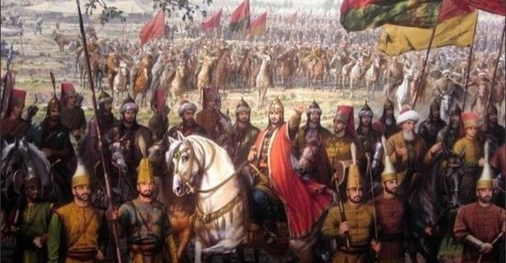
New Age begins :
Istanbul was declared the new capital of Ottoman Empire. With the conquest of Istanbul, the 1058-year Byzantine Empire dissipated, the Middle Age ended and the New Age began.

Slide 13
Other Conquests of Sultan Mehmed II
Conquest of Serbia (1454–1459)
Conquest of Morea (1458–1460)
Conquest of Trebizond (1460–1461)
Submission of Wallachia (1459–1462)
Conquest of Bosnia (1463)
Ottoman-Venetian War (1463–1479)
Anatolian conquests (1464–1473)
Conquest of Albania (1466–1478)

Slide 14
Thanks for listening
Burak Bora Anatolian Highschool

Slide 15
Project Sponsor :
Teacher : Suzan Pıçakçı
Speaker : Acar Tuna Yılmaz
Editor : Mehmet Akif Yazıcı
Contributors : Mehmet Akif Yazıcı , Elanur Uysal , Rüzgar İpci , Çağla Akdeniz , Ali Burak Bayram

